Slide 1
Evaporator design
Week -4
By
Dr.Swambabu Varanasi
Dr. Koustav Ray

Slide 2
Quick review
Double pipe HE is economically beneficial when required heat transfer area less than 50 m².
Finned double pipe HE is used when h_{shell} < 0.75 h_{tube}
Criteria and methodology used is similar for both except
equivalent diameter calculations O
Outer surface area consideration for calculating U_{o}
Key aspects
Shell side and tube side streams, Caloric temperature estimation
Usage of appropriate correlations
TEMA guidelines
Reading heat transfer data tables, graphs, etc

Slide 3
Evaporation
Evaporation is the removal of solvent as vapor from a solution.
Applications
To concentrate the solutions like sugar syrup, fruit juice, paper mill effluents, caustic soda lye, urea solution, etc.
To produce crystals in case of evaporative crystallization like ammonium sulfate crystals, salt, etc..
How do we remove solvent from a solutions?
Heating the solution
By applying vacuum
Combined – Usual procedure

Slide 4
Evaporation system
Vacuum
generator
Heat exchanger
Feed
Concentrated
Product
Is this possible (practically) ?
Can vapours enter the vacuum generator directly?
No, vapour disengagement space need to be provided
Vapours should be condensed
Flowability of the concentrated solution?

Slide 5
One possible arrangement – natural circulation evaporator
Vacuum
generator
Condenser
Condensed
vapours
Heat exchanger
Feed
Concentrated
Product

Slide 6
Another possible arrangement – Forced circulation
Vacuum
generator
Condenser
Condensed
vapours
Heat exchanger
Feed
Concentrated
Product

Slide 7
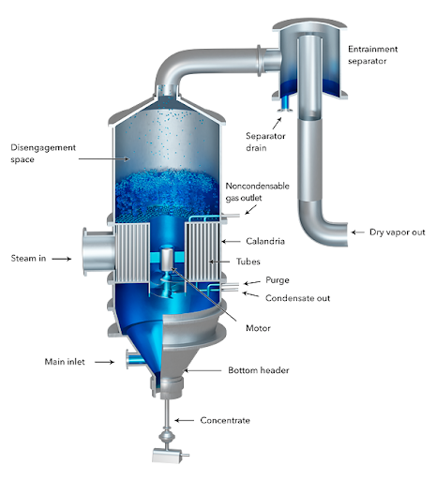
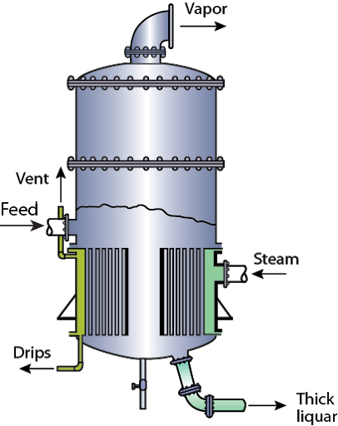
Short tube Calandria type evaporator
Image from - http://eacharya.inflibnet.ac.in/data-server/eacharya-documents/55daa452e41301c73a2cb5ac_INFIEP_208/386/ET/5.html and thermopedia

Slide 8
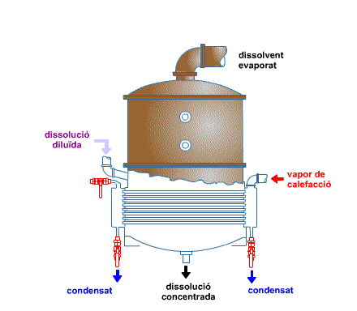

Slide 9
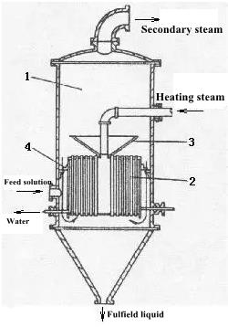
Basket type evaporator
Image from lixingtitanium.com/info/hanging-baskets-evaporator-2255721.html

Slide 10
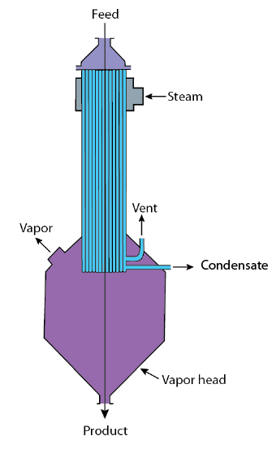
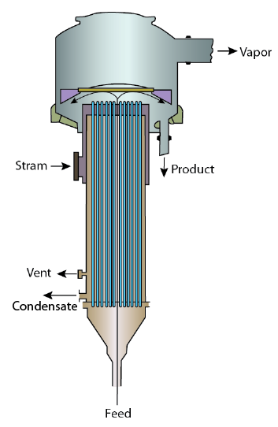
Film-type evaporator
Climbing film evaporator
Falling film evaporator

Slide 11
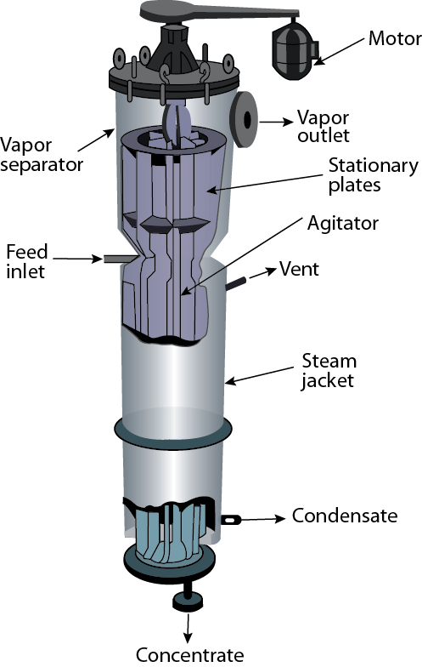
Agitated Thin Film Evaporator

Slide 12
Another possible arrangement – Forced circulation
Vacuum
generator
Condenser
Condensed
vapours
Heat exchanger
Feed
Concentrated
Product

Slide 13
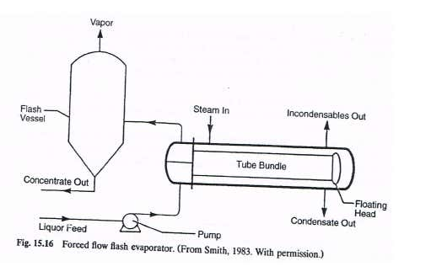
Flash Evaporator

Slide 14
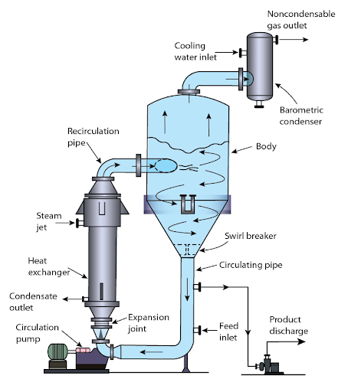
Forced circulation evaporator
Image from - http://eacharya.inflibnet.ac.in/data-server/eacharya-documents/55daa452e41301c73a2cb5ac_INFIEP_208/386/ET/5.html

Slide 15
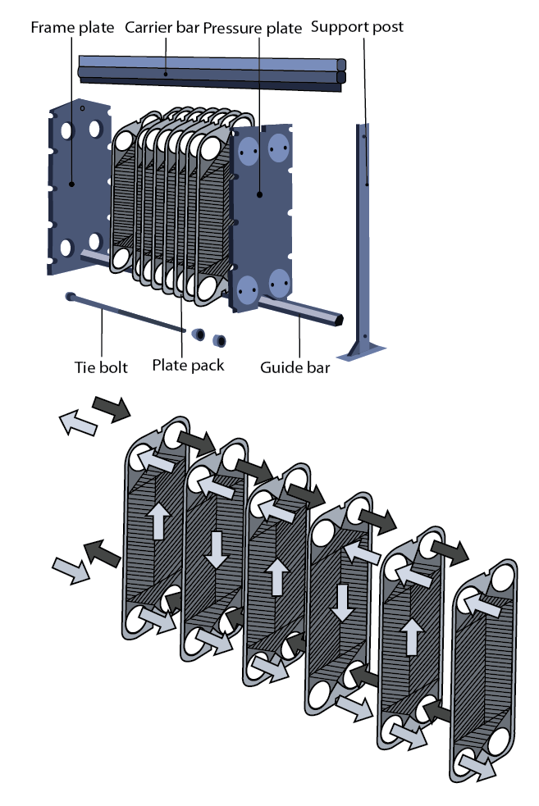
Gasketed Plate Evaporator

Slide 16
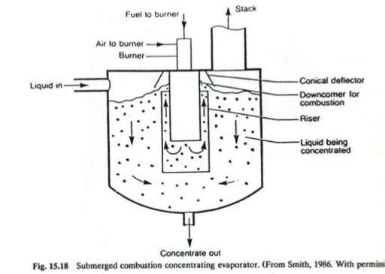
Direct contact evaporator

Slide 17
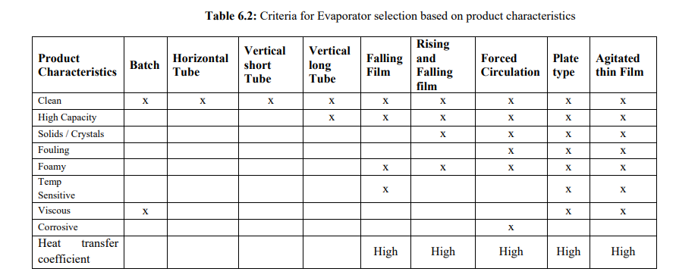
Criteria for evaporator selection

Slide 18
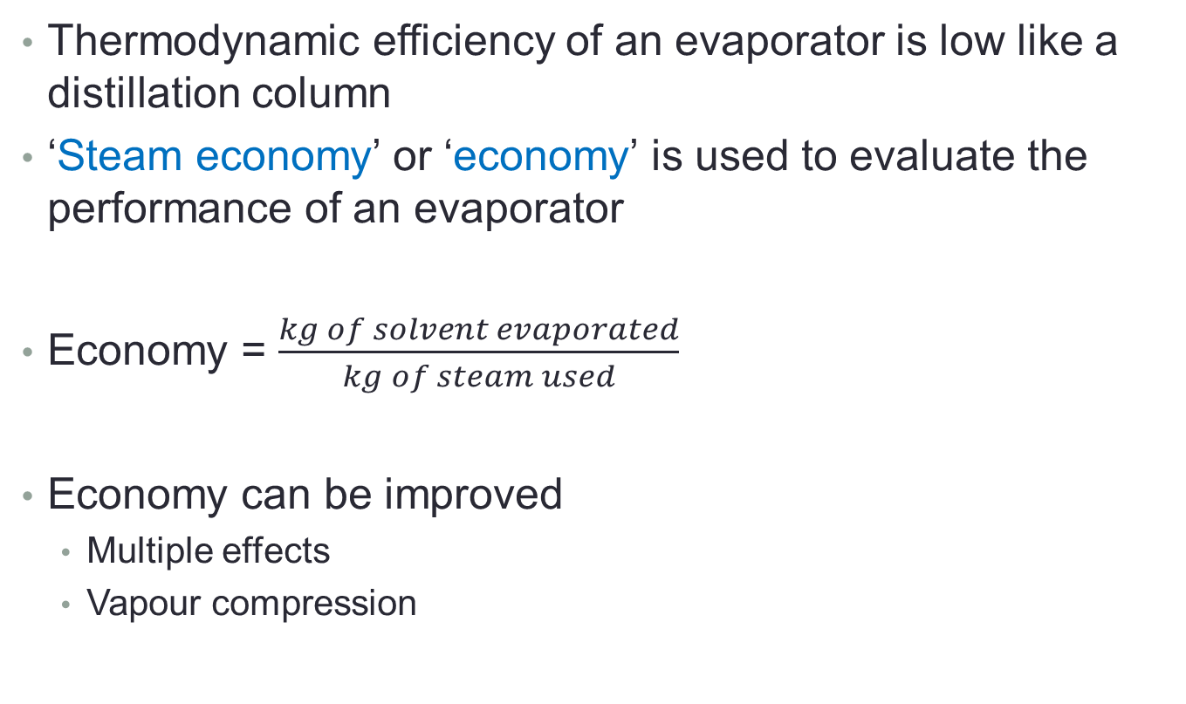
Evaporator performance
Thermodynamic efficiency of an evaporator is low like a distillation column
‘Steam economy’ or ‘economy’ is used to evaluate the performance of an evaporator
Economy = $\frac{kg of solvent evaporated}{kg of steam used}$
Economy can be improved
Multiple effects
Vapour compression

Slide 19
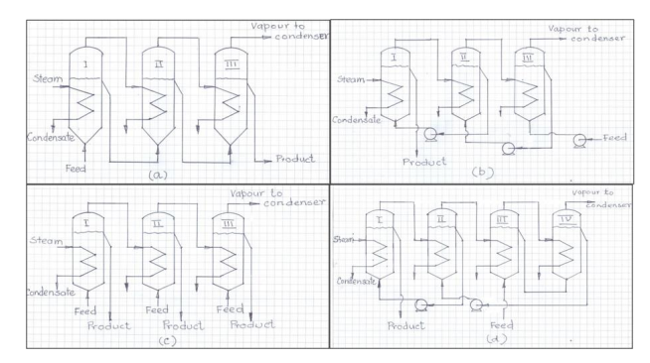
Multiple effect evaporator
Feed forward
Feed backward
Parallel Feed
Mixed feed backward

Slide 20
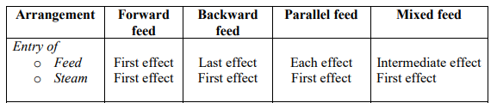
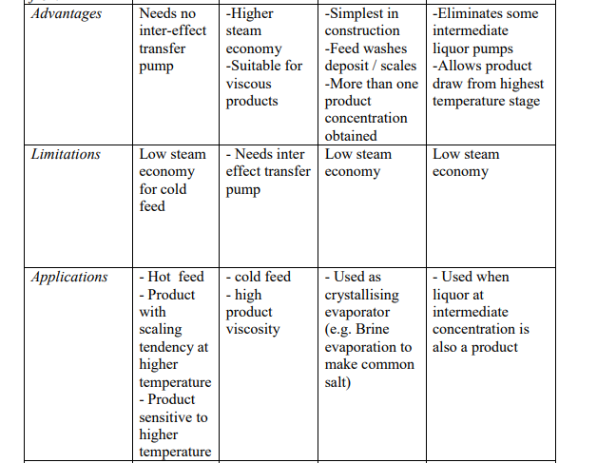

Slide 21
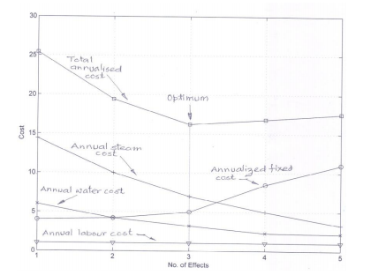
Optimum number of effects

Slide 22
Evaporator design
It should
effectively transfer heat at a high rate with minimum surface area
effectively separate vapour from liquid concentrate
meet solvent evaporation capacity
meet product quality (concentration)
be energy efficient by effective use of steam in multiple-effect evaporation or vapour recompression, wherever possible
minimize fouling of heat transfer surface
be constructed of materials that are adequate to minimize corrosion

Slide 23
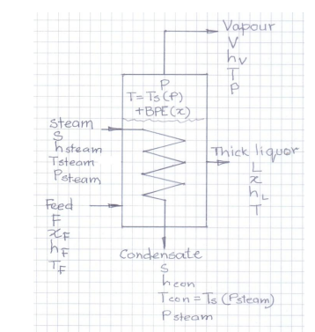
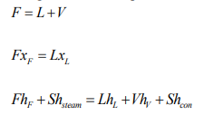


Single effect evaporation
Mass and Energy balance
Where T_{con} = steam condensate T
T is the bulk liquid temperature

Slide 24
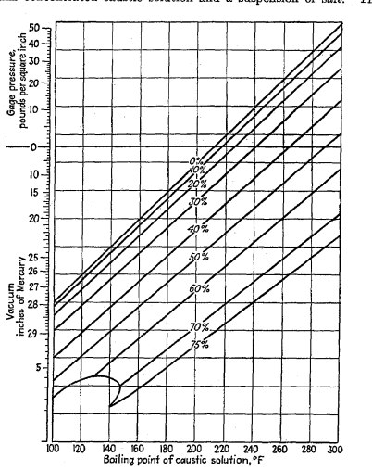
Boiling point Elevation
BPE

Slide 25
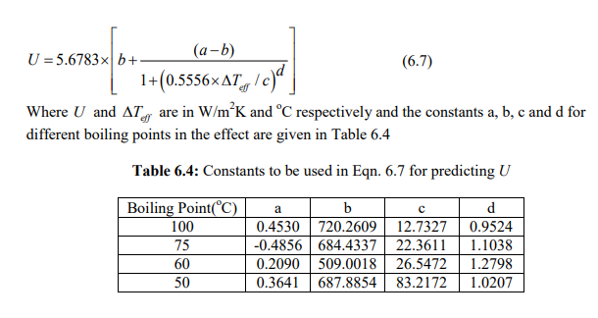
Overall heat transfer coefficient
Badger and Shepard (AIChE Trans. 13(I):101-137(1920)) for 30”diameter evaporator with 24 numbers of 2” diameter 48”long tubes

Slide 26
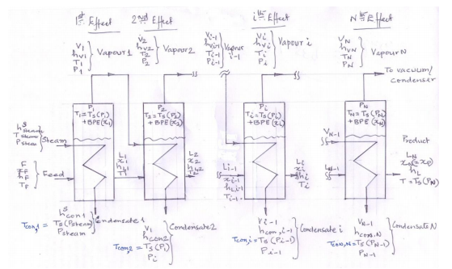
Multiple effect evaporator

Slide 27
Design input
Feed rate (F), feed conditions (x_{F}, T_{F}) and desired product concentration (x_{P})
Pressure (P_{N}) in N^{th} stage (last effect).
System properties – calculation procedure and / or tables for saturation temperature of solvent (water: steam tables), BPE, enthalpy of solution and solution properties.
Steam supply pressure and temperature (P_{steam} and T_{steam}). Usually T_{steam} will have a few degrees of superheat.
Evaporator type & configuration and the estimated heat transfer coefficient of each effect (U1, U2,...UN).

Slide 28
Design solution
Design objective
Meeting the final product concentration with high steam economy is the foremost objective.
The multiple effect evaporator design (triple effect) with same heat transfer area for each effect.
This is an indirect way to economise on fabrication cost and minimise inventory cost by holding common spares
Design deliverable:
The heat transfer areas (A_{i} , i=1,...,N)
all variables not specified as design input

Slide 30


Note the inputs: N, F, xF, TF, PN, U1, U2,...UN
Find the value of T_{s} (P_{N}) from steam table
Estimate L_{N} and V_{total}
Assume V_{i} = V_{total} / 3
Calculate L_{i} and x_{i}
Estimate BPE from Duhring’s plot
Assuming equal area

Slide 31

Estimate Temperatures (condensate and products) in each effect
Estimate enthalpy's from steam tables and data tables
Calculate steam and heat load
Calculate based on given overall heat transfer coefficient
Check: see whether assumed condition (equal area) satisfied or not?
Yes – move forward
No -

Slide 32
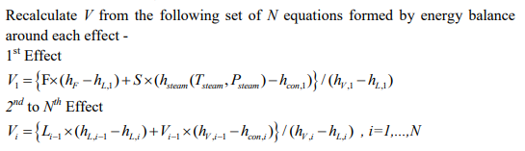

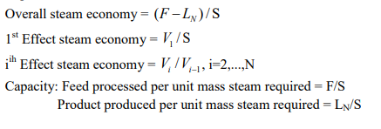
Check

Slide 33
Design a forward feed triple effect evaporator to concentrate X1% w/w caustic soda solution to a product with X2 w/w NaOH. Feed liquor is available at F kg/sec at TºC. Last effect of the evaporator can be connected to an existing vacuum system and operated at a pressure of P kPa (abs). Steam with negligible superheat is available at 120ºC. Estimated overall heat transfer coefficients for the effects are 3000, 2000 and 1250 W/(m2C), defined with respect to the difference in temperature of the liquid in the effect and the condensing temperature of steam/vapour heating it.
Estimate:
Steam consumption
Heat load
Heat transfer area, Operating temperature, Pressure and Condensate temperature in each effect.

Slide 34

Data for assignment question
Steam tables: uploaded to teams (files folder)
or access from:
https://www.nist.gov/system/files/documents/srd/NISTIR5078.htm

Slide 35
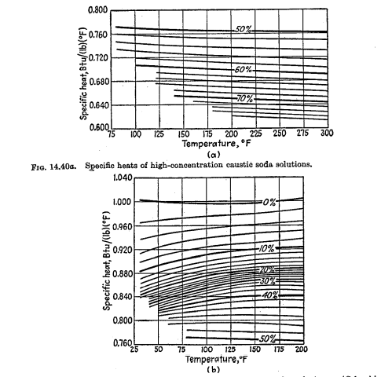

Slide 36
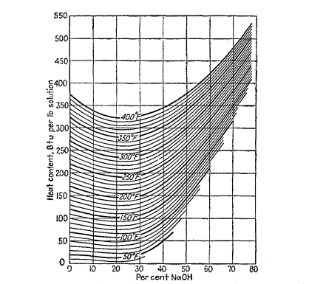

Slide 37
